Slide 1

Restaurant Management System
Developed By Group No : 01
Semester: Fall 24
Course Title: Software Development Capstone Project
Course Code: SE133
Batch:41
Section:E1

Slide 2
Group-1
Members
Imtiaz Ibna Kamal (232-35-680)
Jubaidul Islam Rimon ( 232-35-154)
Salim Sadman (232-35-129)
Akash Roy (232-35-141)
Sabbir Alam Alif (232-35-160)

Slide 3
Presented to
Course Teacher: Most. Munira Tabassum
Lecturer
Department of Software Engineering
Faculty of Science & Information Technology
Daffodil International University

Slide 4
Introduction
The Daffodil Green Garden Restaurant Management System is designed to make the restaurant’s daily operations more efficient by keeping track of inventory, sales, and order processing.
The primary goal of this system is to allow restaurant administrators to perform the following tasks:
Login into the system.
Manage inventory by adding, updating, and deleting dishes.
Process customer orders and generate bills.
View total sales reports.

Slide 5
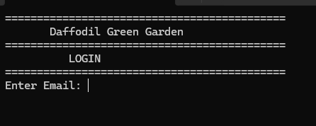
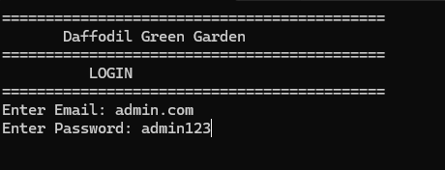
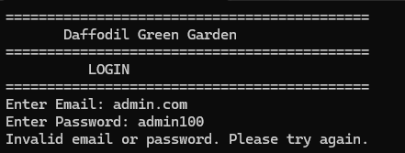
Login System
Inputs: The system will ask for the administrator’s email and password.
Validation: The inputted email and password will be compared against the predefined values (admin.com and admin123).
Output: Upon successful login, the system will proceed to the admin menu.
If the password/user are incorrect, the system will display an error message and prompt the user to try again.

Slide 6
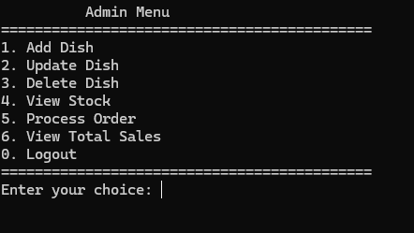
Admin Menu
Add, Update, Delete Dish
View Stock
Process Order
View Total Sales
Logout

Slide 7
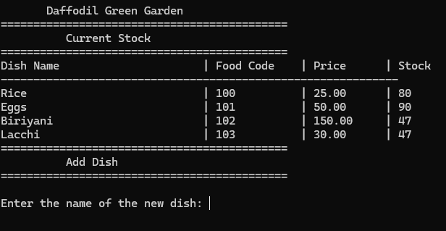
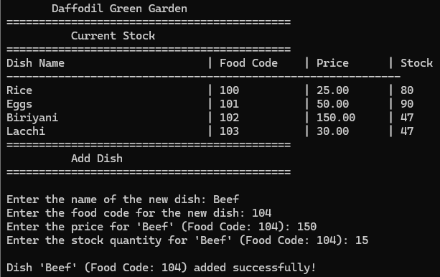
Add Dish
The admin can add a new dish by entering its name, food code, price, and stock quantity.

Slide 8
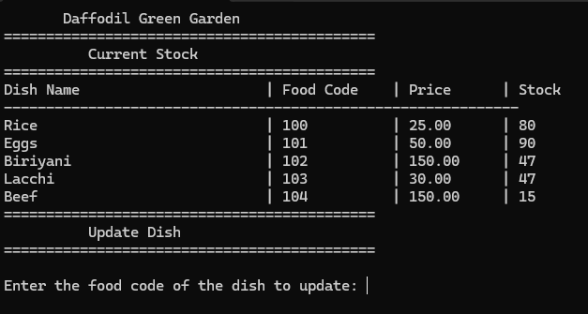
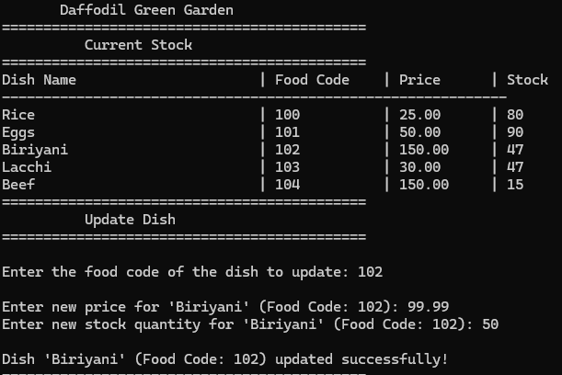
Update Dish
The admin can update the price and stock of an existing dish.
System will ask for food code
Then new price
Then new stock

Slide 9
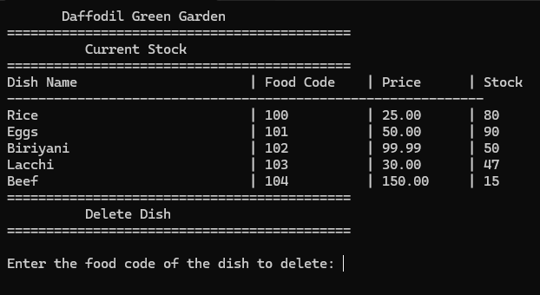
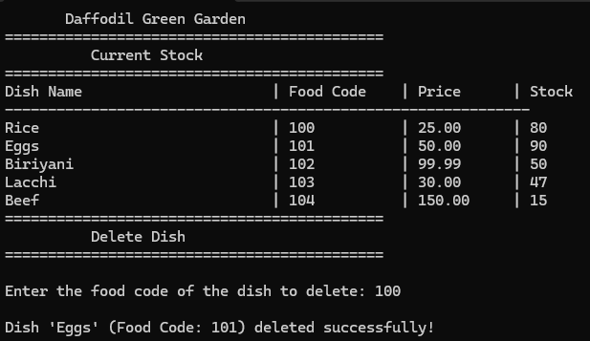
Delete dish
The admin can delete a dish by entering its food code.
The dish will be removed from the inventory.

Slide 10
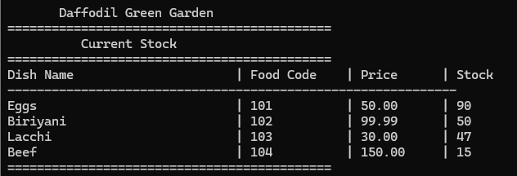
View Stock
Admin can check :
Dish name,
Food code
Price
Remaining Stock

Slide 11
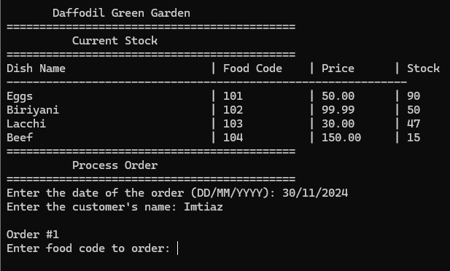
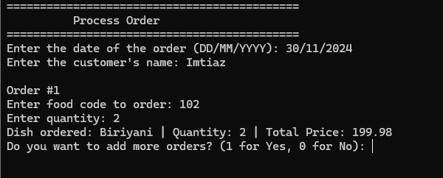
Process Order
Admin enters the customer’s name and order date.
At first It will ask for food code,Quantity,
Confirms the order.

Slide 12
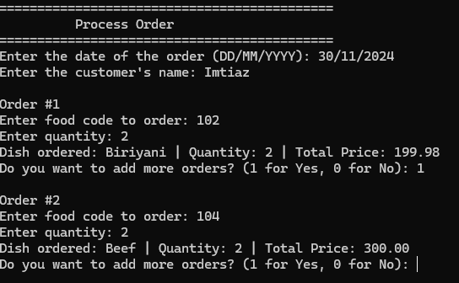
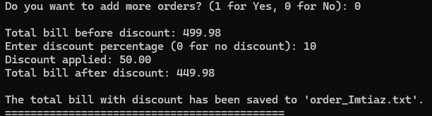
Process Order
The admin can add multiple orders (dishes) by choosing 1(yes) and 0(no)
The system will ask for a discount if requested and calculates the final price.

Slide 13
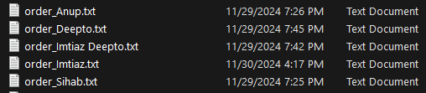
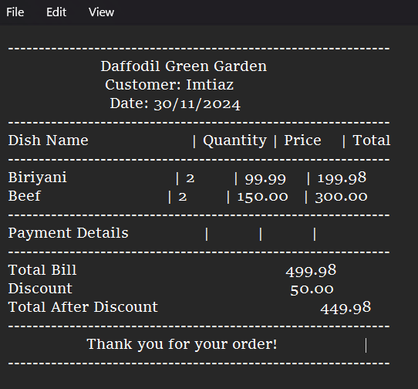
Generate Bill
The system generates a bill in .txt file for invoice of order
The bill includes details such as dish name, quantity, total price, and total cost of the order.

Slide 14
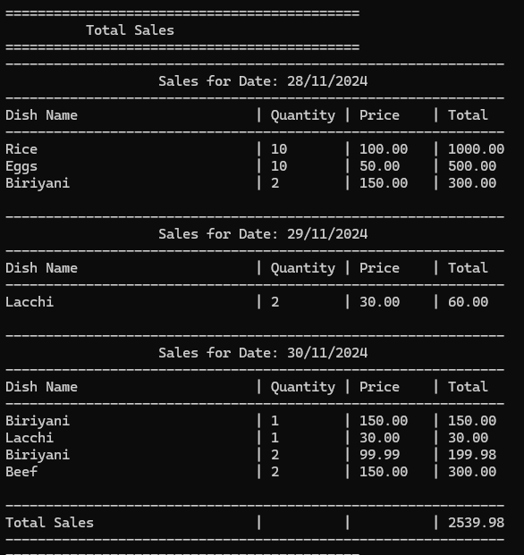
Total sales
The system tracks sales and shows the total sales for each day.
The admin can view sales with the date, dish name, quantity sold, price, and total price.
The system generates a report showing total sales for all dishes sold across multiple days.

Slide 15
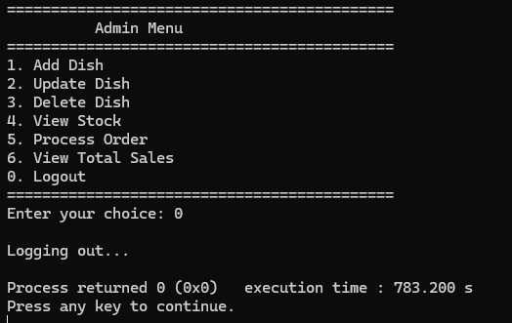
Logout
Exits the admin menu and logs out from the system.

Slide 16
Thank you
For you time and Attention

